Slide 1


Gridlock Hackathon 2.0
Problem Statement
Automated Photo Identification and Classification for Traffic Violations Using Computer Vision
Team Name : BYTEA
Team Members : Satvik Yadav
Amit Chaurasiya
Pratik Uppadhyay

Slide 2
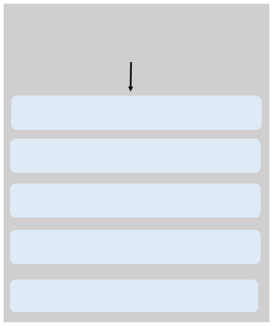

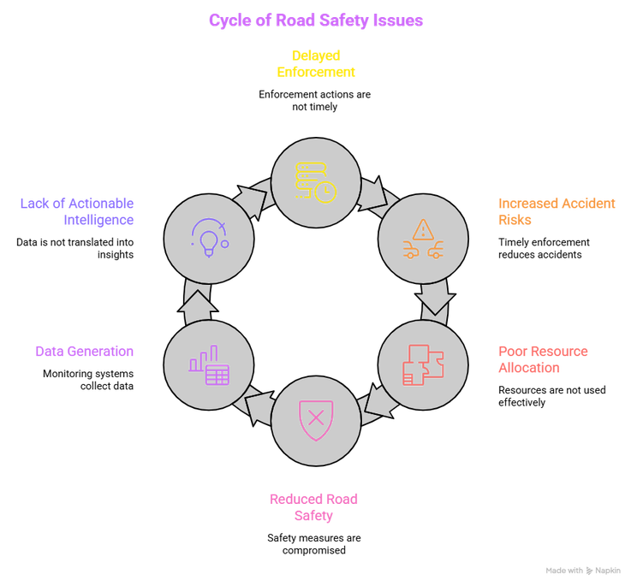
PROBLEM STATEMENT
Impact
Current Challenges in Traffic Enforcement Problems Faced by Authorities
Manual review of traffic camera footage is
slow and labor-intensive
Thousands of violations occur daily but
limited manpower is available
High-risk locations remain unidentified until
accidents occur
Lack of real-time analytics and enforcement
prioritization
License plate extraction and evidence
generation require manual effort

Slide 3
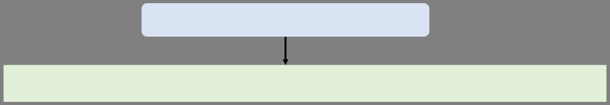


Proposed Solution
TraffiSenseAI
An AI-powered traffic intelligence platform that automatically detects, analyzes, and prioritizes road violations.
Core Features
Benefits
• • • • • • •
•
Faster Violation Review
Automatically detects violations, reducing review time.
Traffic image upload and processing.
•Reduced Manual Workload
Automatic violation detection using YOLOv8.
Automates evidence generation and license plate extraction.
Improved Traffic Enforcement
Helps authorities prioritize high-risk violations and hotspots.
License plate extraction using OCR.
•
Severity score calculation
• • •
Data-Driven Decisions
Evidence generation for enforcement teams Smart City Safety Index
Provides analytics and insights for better planning.
Enhanced Road Safety
Identifies risky behavior to help prevent accidents. Smart City Support
Enables intelligent and scalable traffic management.
Interactive analytics and heatmaps

Slide 4
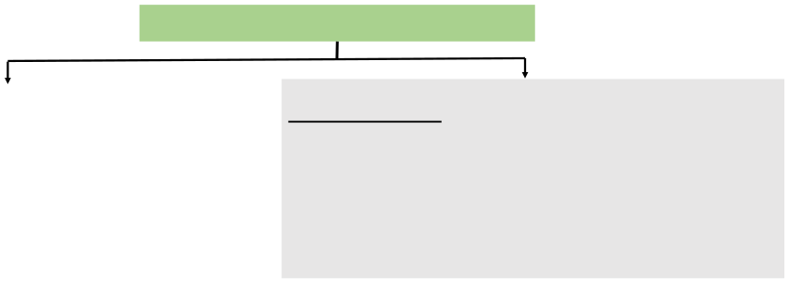





AI Processing Pipeline
Traffic Image Upload
↓
Violations Detected
Image Preprocessing (OpenCV)
↓
• • • • •
Helmet Non-Compliance Triple Riding
Wrong Side Driving Illegal Parking
License Plate Recognition
AI Stack
YOLOv8 Object Detection
↓
Violation Detection Engine
↓
License Plate OCR
↓
Severity Score Engine
↓
Evidence Generation
FastAPI
OpenCV
↓
Database Storage
↓
Dashboard & Analytics
EasyOCR
YOLOv8

Slide 5

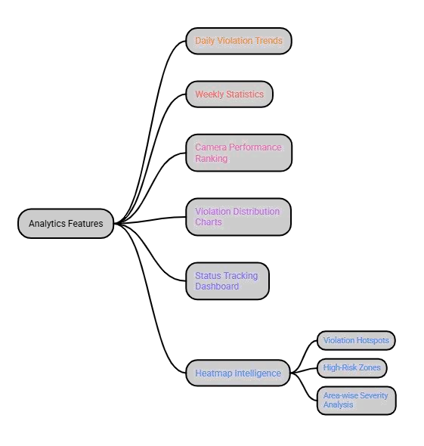
Dashboard & Analytics
Smart Enforcement Dashboard
Real-Time Monitoring
❑    
Total Violations
Vehicles Analyzed Critical Alerts
Peak Traffic Hours
Safety Index

Slide 6
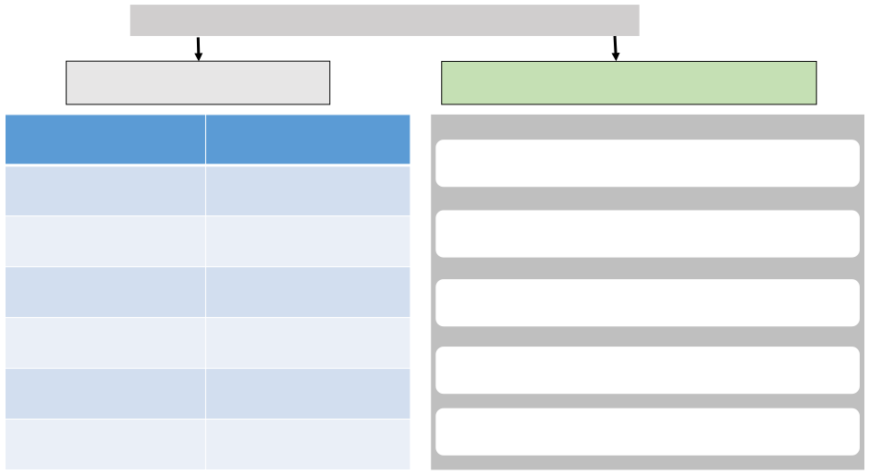
Smart City Safety Index & Recommendations
Intelligent Risk Assessment Severity Scoring Model
AI Recommendations
Violation Type
Score 20
Increase patrol deployment in hotspot zones
Helmet Violation Triple Riding
30
Focus enforcement during peak violation hours
Wrong Side Driving
35
Install additional cameras in critical areas
Illegal Parking
15
Prioritize school zones and accident-prone roads
Night-Time Risk
+10
School Zone Risk
+15
Launch awareness campaigns for frequent violations

Slide 7
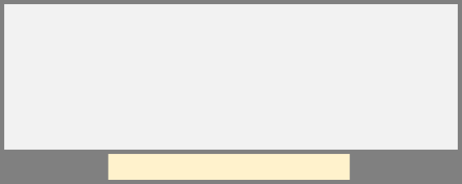














Deployment, & Future Scope
Frontend
Future Enhancements
•Vite
Tailwind CSS •Chart.js •Leaflet Maps •React
• • • • • •
Live CCTV Stream Processing
Real-Time Violation Alerts Multi-City Deployment GPU-Based AI Inference
Backend & Deployment
SQLAlchemy
FastAPI
PostgreSQL
Automated E-Challan Integration Role-Based Government Access
Backend
Deployment
Docker Compose
Docker
Vercel (Frontend)
Nginx

